Slide 1
Topic 2: Is the Gaussian probability density function boring?
Histogram & Bayes Classifier (TWO DIMENSIONS)
Assignment 2 (unofficial)
Step-by-step: How can I build 2D Histograms?
Looking good, Bayesian!
Histogram & Bayes Classifier (TWO DIMENSIONS)
Histogram & Bayes Classifier (TWO DIMENSIONS)
Mean Vectors
Two Dimensional Data
Two Dimensional Data
Two Dimensional Data
Two Dimensional Gaussian Intuition
Two Dimensional Gaussian Intuition (more general)
What does an “outlier” mean?
Distances are not what they seem to be
Why bother with the multivariate normal formula?
How do I specify a 1D point cloud?
How do I specify a 2D point cloud?
How do I specify a 2D point cloud?
Covariance Interpretation Practice
Correlations between features
Covariance Matrix: Summary of correlations between features
Covariance: What does it measure?
Covariance versus variance
Covariance formula
Bayes Classifier (d DIMENSIONS)
Step-by-step: PDF of the binormal distribution
Calculation of the PDF of the binormal distribution
Calculation of the PDF of the multinormal distribution
Step-by-step: How can I build a 2D Bayesian Classifier?
Topic 2 Summary

Slide 2
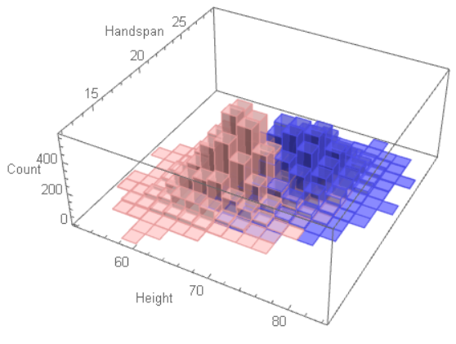


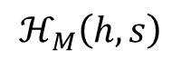
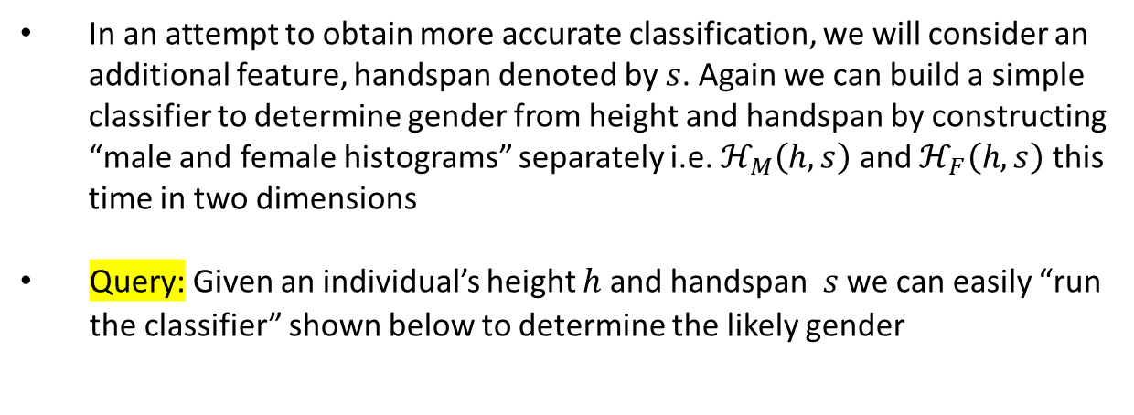
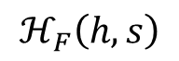
Histogram & Bayes Classifier (TWO DIMENSIONS)
In an attempt to obtain more accurate classification, we will consider an additional feature, handspan denoted by $s$. Again we can build a simple classifier to determine gender from height and handspan by constructing “male and female histograms” separately i.e. $ℋ_{M}\left(h,s\right)$ and $ℋ_{F}\left(h,s\right)$ this time in two dimensions
Query: Given an individual’s height $h$ and handspan $s$ we can easily “run the classifier” shown below to determine the likely gender
M
$$ℋ_{M}\left(h, s\right)$$
>
$$ℋ_{F}\left(h, s\right)$$
<
F
Can we use formulas to represent idealized versions of these histograms?
Sandeep Gautham, you have been honored with the Eagle Eye Award for spotting errors on the previous slide.
Congratulations and thank you for your help in improving this presentation.
CLICK TO DISMISS

Slide 3
Assignment 2 (unofficial)
The dataset that you need is in one of the sheets of the Excel file attached. The other sheets contain shaded cells meant to be filled in by you. Examine the sheets carefully and understand what must be computed or described. Except for cutting and pasting your results in the specific cells provided, do not alter the spreadsheet in any other way. This is the only recognized means of submitting this assignment.
Construct separate 2D histograms for male and female heights. You decide on the number of bins to use, making sure there is sufficient resolution and bin-filling. Represent height in rows, and handspan in columns -- both in ascending order of magnitude of the feature. Do not use a built-in histogram program.
Find the parameters of two 2D Gaussian models for the 2 PDFs to describe the data. Let the first dimension represent height, and the second dimension represent handspan. You may use built-in functions to compute these parameters, but do not use a built-in function to compute the pdf.
Based on the histograms and Gaussian models, compute the likely gender (with probability) of individuals with measurements as given below (Height in inches, handspan in centimeters). What are your observations?
Height Handspan 69 17.5 66 22 70 21.5 69 23.5
Extra credit: Reconstruct a histogram using female model parameters that can be compared to the female histogram constructed in Part 2. Similarly, reconstruct a histogram using male model parameters.

Slide 4
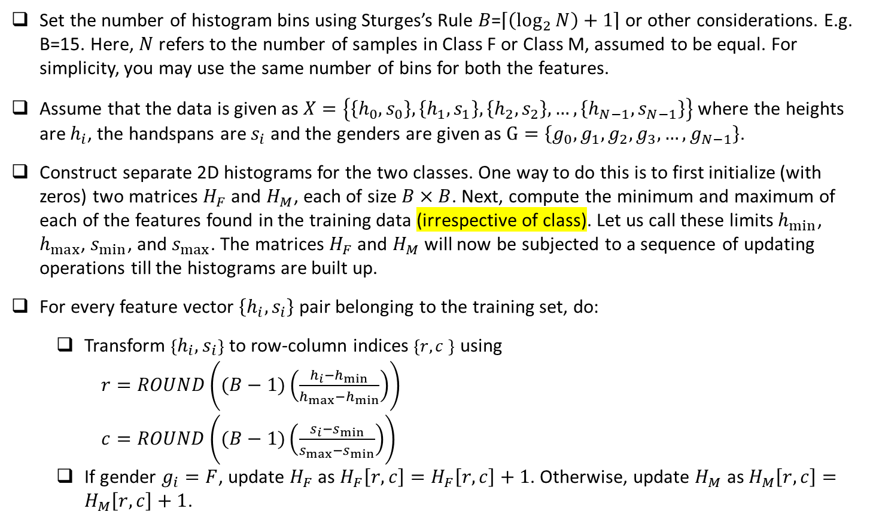
Step-by-step: How can I build 2D Histograms?
Set the number of histogram bins using Sturges’s Rule 𝐵=$\left\lceil \left(\log_{2}{N}\right)+1\right\rceil$ or other considerations. E.g. B=15. Here, $N$ refers to the number of samples in Class F or Class M, assumed to be equal. For simplicity, you may use the same number of bins for both the features.
Assume that the data is given as $X=\left\{\left\{h_{0},s_{0}\right\},\left\{h_{1},s_{1}\right\},\left\{h_{2},s_{2}\right\},…,\left\{h_{N−1},s_{N−1}\right\}\right\}$ where the heights are $h_{i}$, the handspans are $s_{i}$ and the genders are given as $G=\left\{g_{0},g_{1},g_{2},g_{3},…,g_{N−1}\right\}$.
Construct separate 2D histograms for the two classes. One way to do this is to first initialize (with zeros) two matrices $H_{F}$ and $H_{M}$, each of size $B×B$. Next, compute the minimum and maximum of each of the features found in the training data (irrespective of class). Let us call these limits $h_{min}$, $h_{max}$, $s_{min}$, and $s_{max}$. The matrices $H_{F}$ and $H_{M}$ will now be subjected to a sequence of updating operations till the histograms are built up.
For every feature vector $\left\{h_{i},s_{i}\right\}$ pair belonging to the training set, do:
Transform $\left\{h_{i},s_{i}\right\}$ to row-column indices $\left\{r,c \right\}$ using
$r=ROUND\left((B−1)\left(\frac{h_{i}−h_{min}}{h_{max}−h_{min}}\right)\right)$
$c=ROUND\left((B−1)\left(\frac{s_{i}−s_{min}}{s_{max}−s_{min}}\right)\right)$
If gender $g_{i}=F$, update $H_{F}$ as $H_{F}\left[r,c\right]=H_{F}\left[r,c\right]+1$. Otherwise, update $H_{M}$ as $H_{M}\left[r,c\right]=H_{M}\left[r,c\right]+1$.

Slide 5

Looking good, Bayesian!
True or False?
The class labels in the equation shown on this slide are A & B.
HP Autonomy’s headquarters in Cambridge, UK.

Slide 6
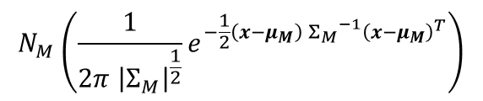
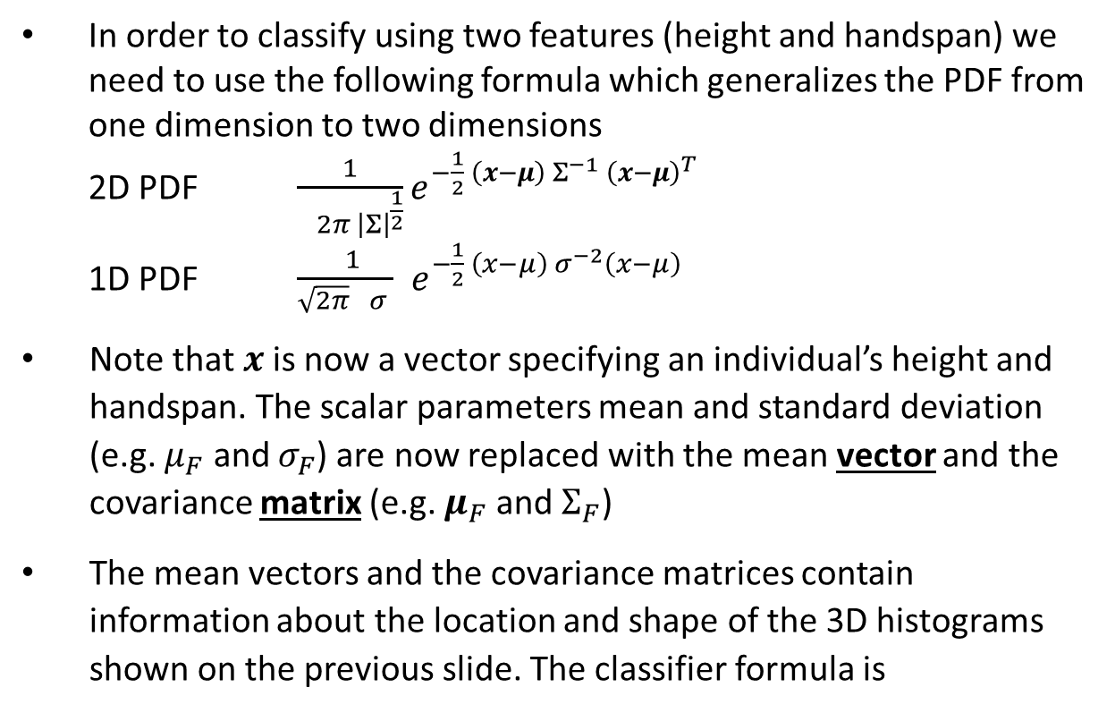
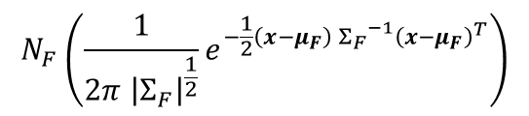
Histogram & Bayes Classifier (TWO DIMENSIONS)
In order to classify using two features (height and handspan) we need to use the following formula which generalizes the PDF from one dimension to two dimensions
2D PDF $\frac{1}{ 2π{ \left|Σ\right|}^{\frac{1}{2}}}e^{−\frac{1}{2} \left(x−μ\right) Σ^{−1} {\left(x−μ\right)}^{T}}$
1D PDF $\frac{ 1}{\sqrt{2π} σ }{ e}^{−\frac{1}{2} \left(x−μ\right){ σ}^{−2}\left(x−μ\right)}$
Note that $x$is now a vector specifying an individual’s height and handspan. The scalar parameters mean and standard deviation (e.g. $μ_{F}$ and $σ_{F}$) are now replaced with the mean vector and the covariance matrix (e.g. $μ_{F}$ and $Σ_{F}$)
The mean vectors and the covariance matrices contain information about the location and shape of the 3D histograms shown on the previous slide. The classifier formula is
$$N_{M}\left(\frac{1}{2π{ \left|Σ_{M}\right|}^{\frac{1}{2}}}e^{−\frac{1}{2}\left(x−μ_{M}\right) {Σ_{M}}^{−1}{\left(x−μ_{M}\right)}^{T}}\right)$$
M
$$N_{F}\left(\frac{1}{2π{ \left|Σ_{F}\right|}^{\frac{1}{2}}}e^{−\frac{1}{2}\left(x−μ_{F}\right) {Σ_{F}}^{−1}{\left(x−μ_{F}\right)}^{T}}\right)$$
>
<
F

Slide 7
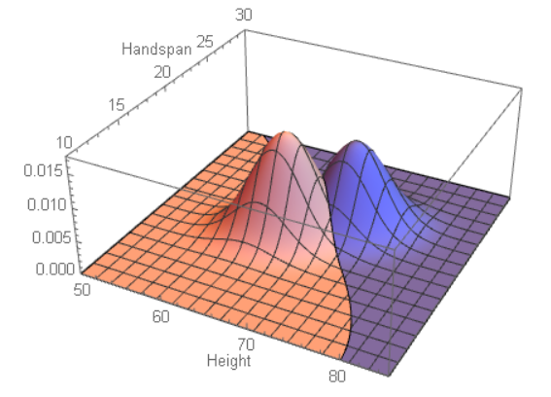
Histogram & Bayes Classifier (TWO DIMENSIONS)

Slide 8
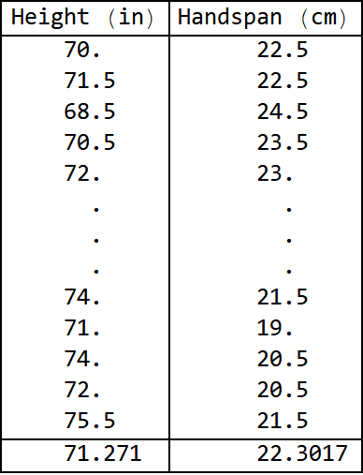
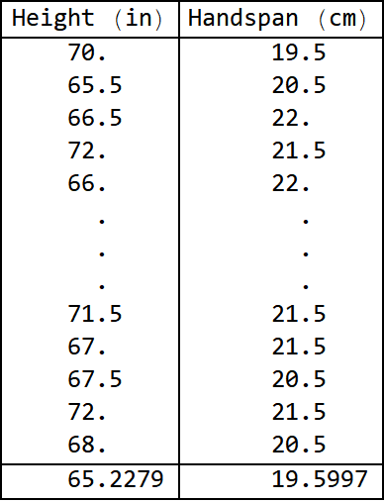
Mean Vectors
Male data (NM=7800)
Female data (NF=8900)
np.mean(....)
Male mean vector
Female mean vector

Slide 9
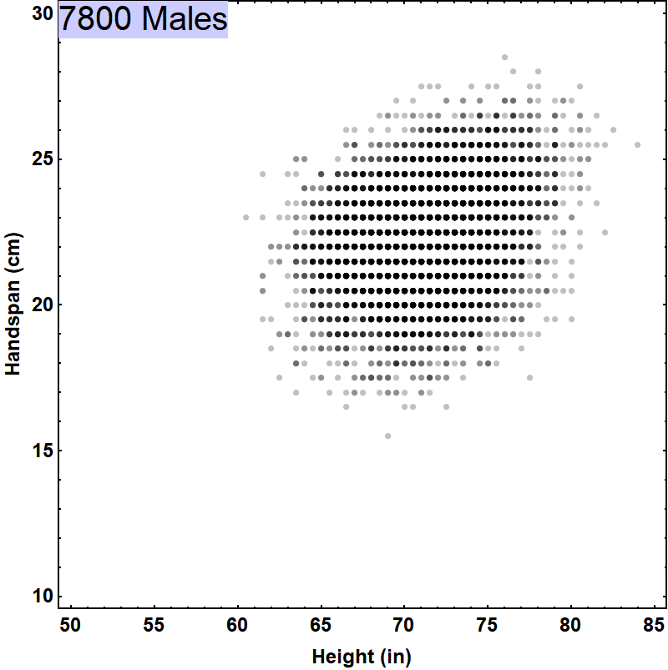
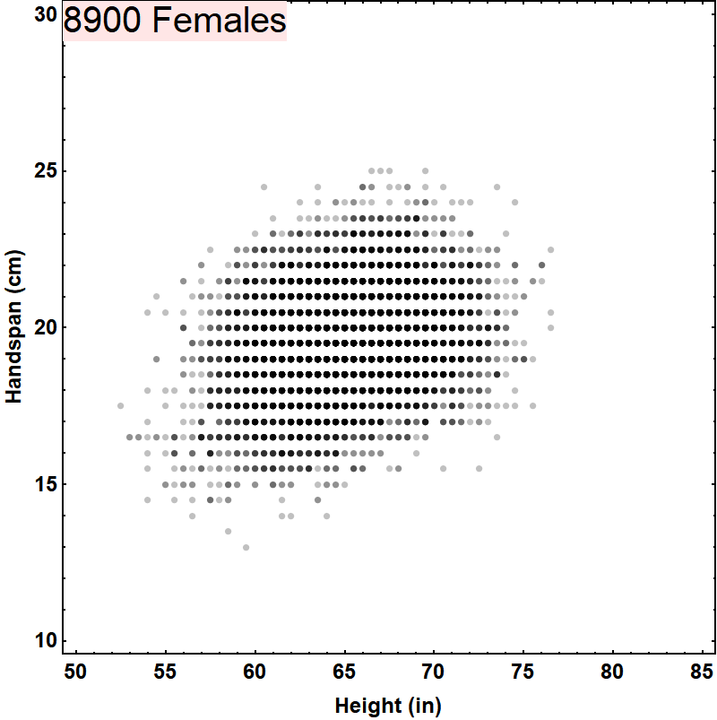
Two Dimensional Data

Slide 10
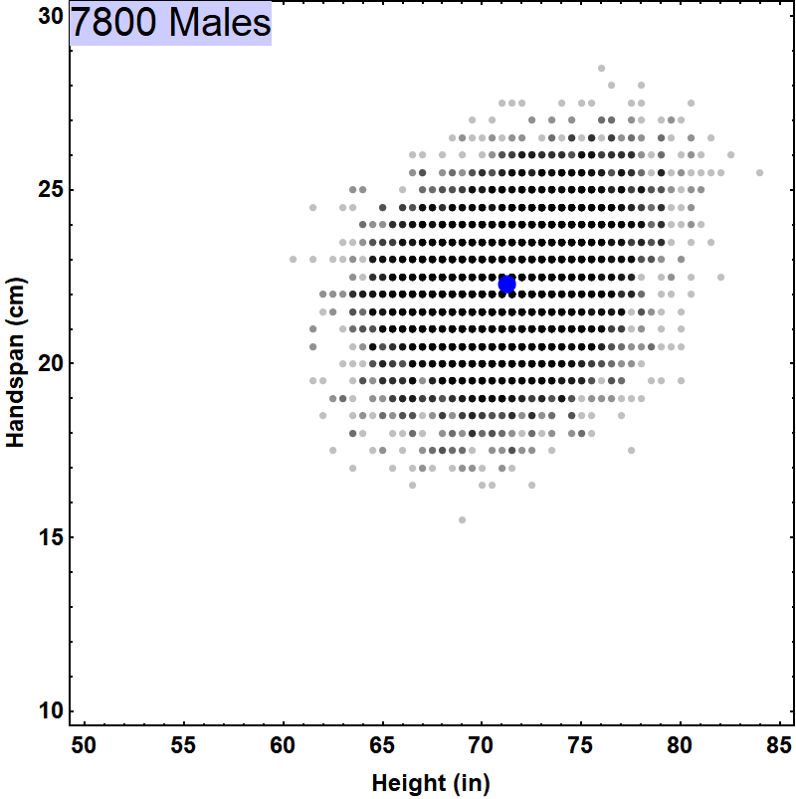
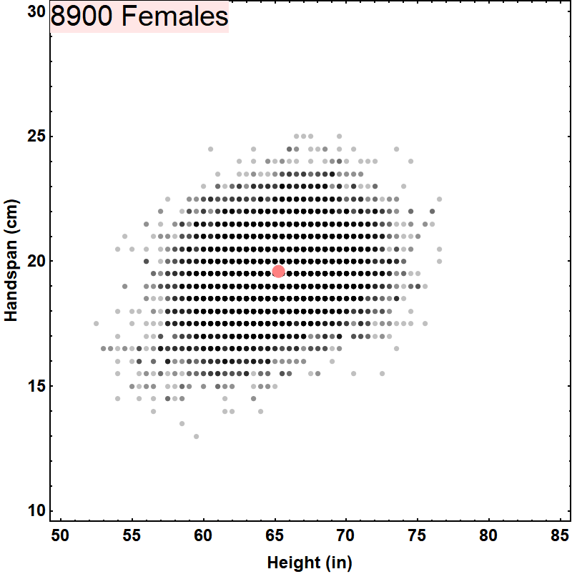
Two Dimensional Data
Male mean vector
Female mean vector
{71.271, 22.3017}
{65.2279, 19.5997}

Slide 11
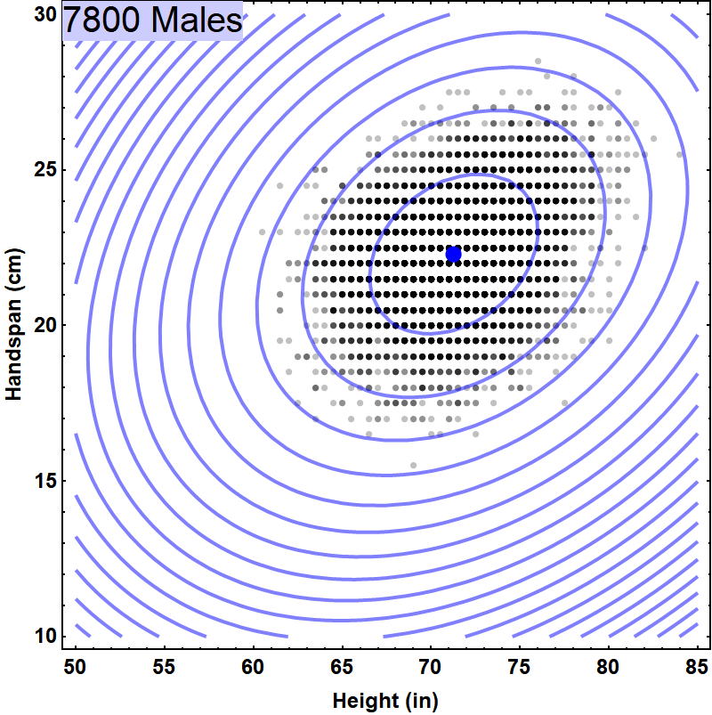
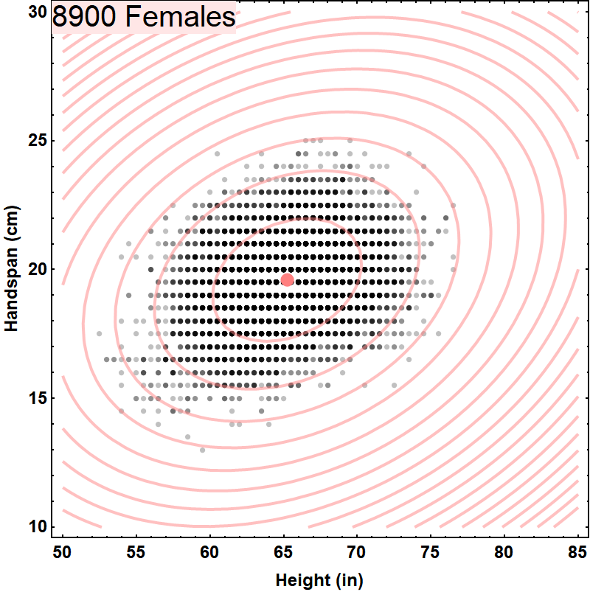
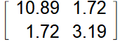
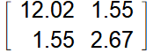
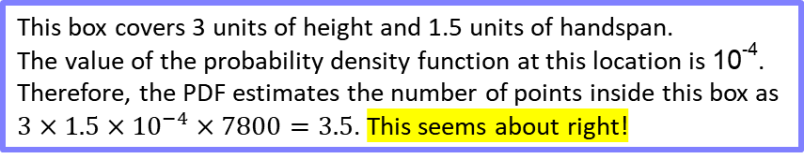
Two Dimensional Data
Male mean vector
Female mean vector
{71.271, 22.3017}
{65.2279, 19.5997}
np.cov(....)
10⁻²
10⁻²
10⁻³
10⁻⁴
10⁻³
10⁻⁴
Male Covariance Matrix
Female Covariance Matrix
This box covers 3 units of height and 1.5 units of handspan.
The value of the probability density function at this location is 10⁻⁴.
Therefore, the PDF estimates the number of points inside this box as
$3×1.5×{10}^{−4}×7800=3.5$. This seems about right!

Slide 12
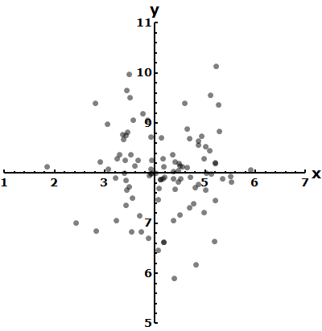
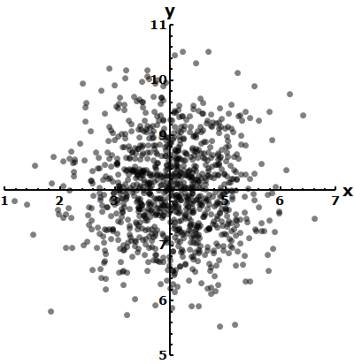
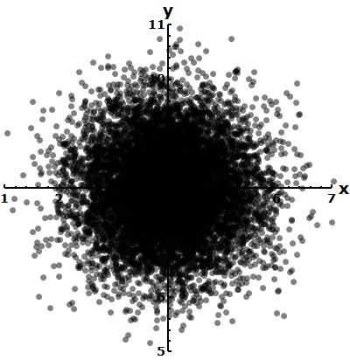
Two Dimensional Gaussian Intuition
Data generated by an unskilled marksman aiming for the point {4,8}. Good luck!
Some more tries …
Even more tries …
Errors are independent of orientation.
Errors in x are independent of errors in y.
Large errors are less probable

Slide 13
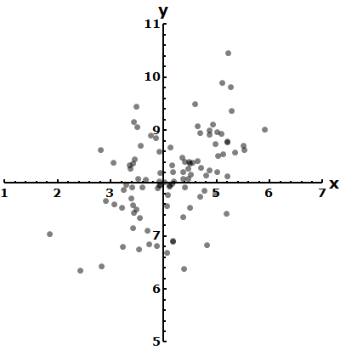
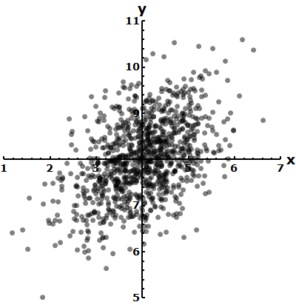
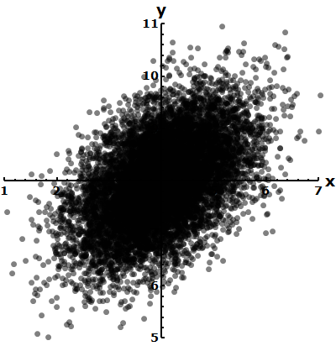
Two Dimensional Gaussian Intuition (more general)
Errors are dependent on orientation.
Errors in x are dependent on errors in y.
Large errors are less probable

Slide 14
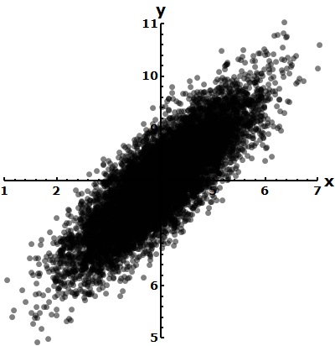
What does an “outlier” mean?
Not an outlier
Is an outlier

Slide 15
Distances are not what they seem to be
Within this distribution, the red and yellow points appear to be effectively equidistant from the center
Within this distribution, the red point appears to be effectively further away from to the center. [Outlier]

Slide 16
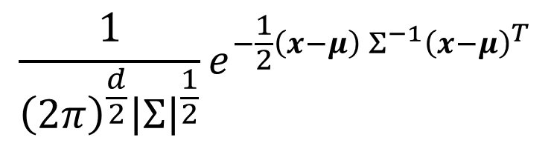
Why bother with the multivariate normal formula?
$$\frac{1}{{\left(2π\right)}^{\frac{d}{2}}{\left|Σ\right|}^{\frac{1}{2}}}e^{−\frac{1}{2}\left(x−μ\right) Σ^{−1}{\left(x−μ\right)}^{T}}$$
Plays a fundamental role in machine learning algorithms.
If you don’t learn this, how will you learn more complex concepts – which abound in machine learning?
At the end of the day, is not all that difficult. Serves to clarify a number of related concepts.
Mathematically tractable, permitting “nice” algorithms.
Practical: Yields useful results even if not exactly applicable to most applications.
Practical: Data can often be transformed to take advantage of normal formulas.

Slide 17
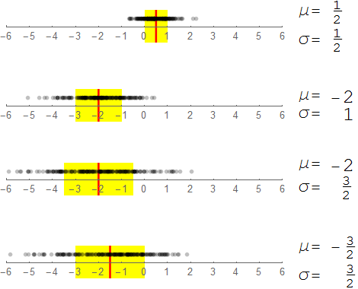
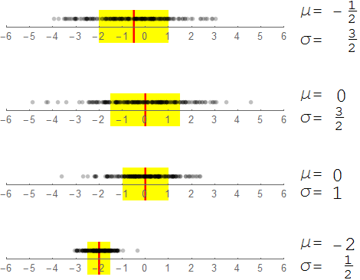
How do I specify a 1D point cloud?
The yellow band encloses 68% of the points

Slide 18
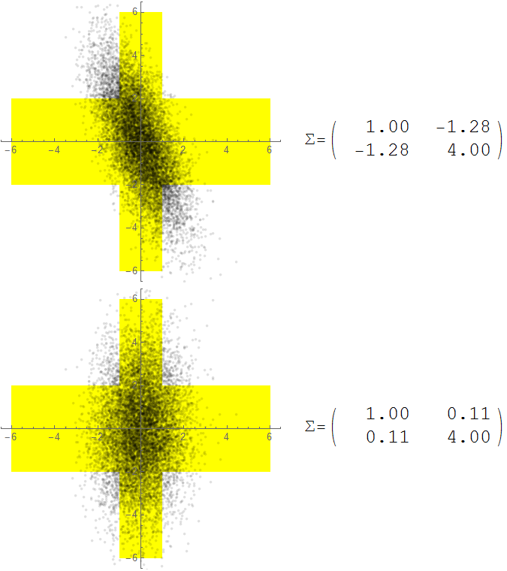
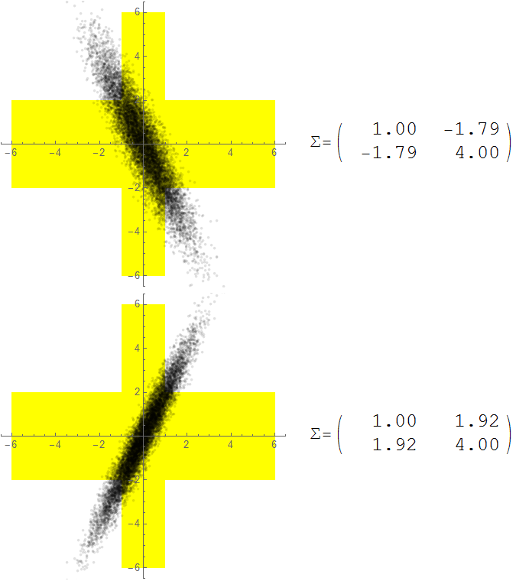
How do I specify a 2D point cloud?
This yellow band encloses 68% of the points
This yellow band encloses 68% of the points
1
2
Variance in the horizontal direction
Variance in the vertical direction
3
4

Slide 19
How do I specify a 2D point cloud?
The standard deviations alone are NOT sufficiently descriptive.

Slide 20
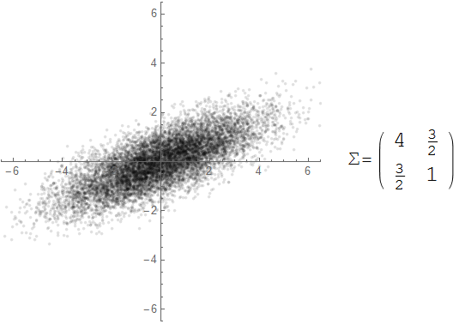
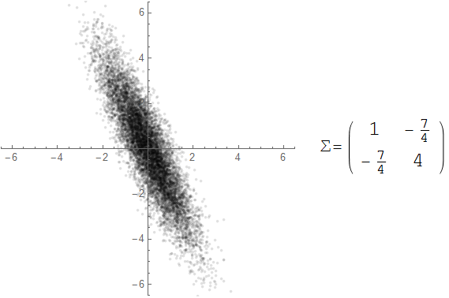
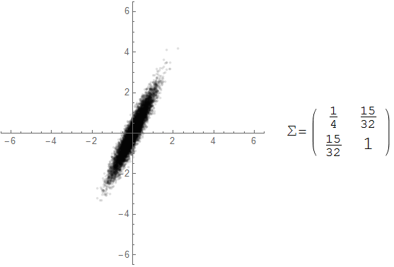
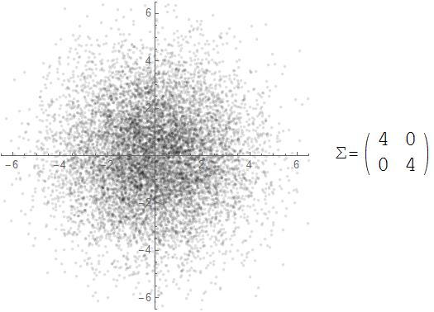
Covariance Interpretation Practice

Slide 21
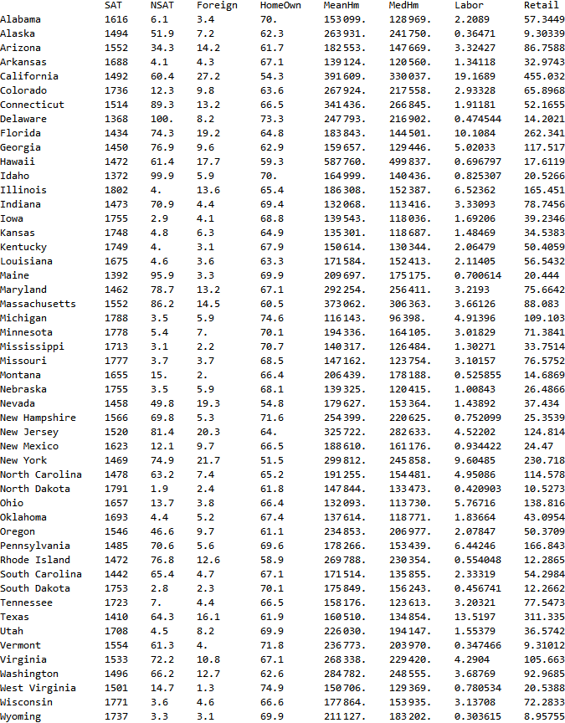
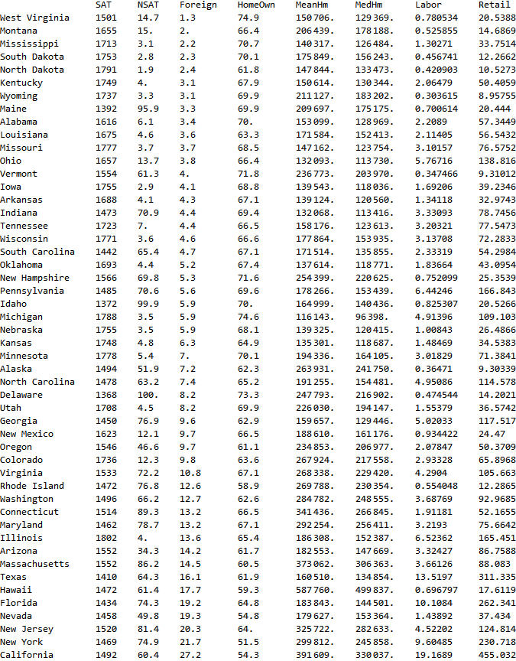
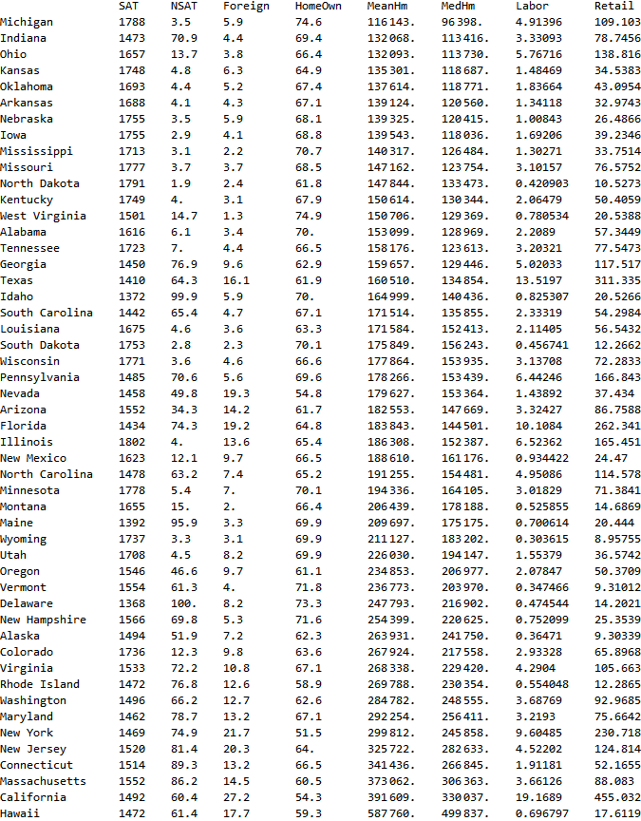
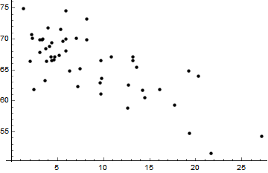
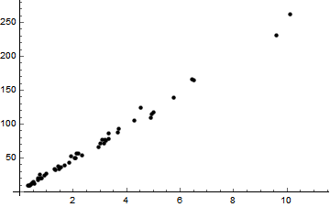
Correlations between features
Fraction Owning home
Fraction foreign-born
Median home price
Mean home price

Slide 22
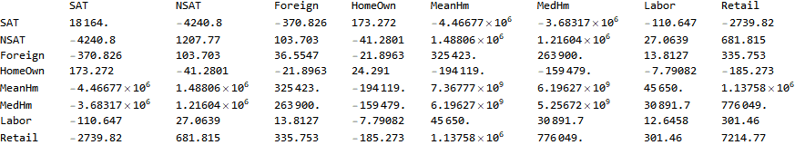
Covariance Matrix: Summary of correlations between features

Slide 23
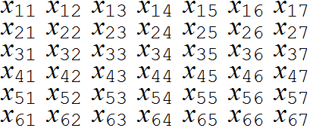
Covariance: What does it measure?
Features
Feature Vectors
N=6
d=7
Are the third and sixth features related?
Across the entire dataset, does one increase when the other increases?
On average, by what amount does the sixth feature increase or decrease when the third feature increases by 1 unit?

Slide 24
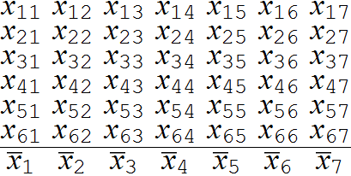
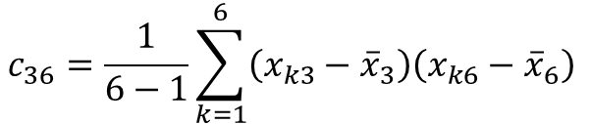
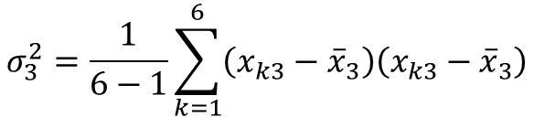
Covariance versus variance
Mean Vector
$$σ_{3}^{2}=\frac{1}{6−1}\sum_{k=1}^{6}{\left(x_{k3}−{\overline{x}}_{3}\right)\left(x_{k3}−{\overline{x}}_{3}\right)}$$
Variance of feature 3
$$c_{36}=\frac{1}{6−1}\sum_{k=1}^{6}{\left(x_{k3}−{\overline{x}}_{3}\right)\left(x_{k6}−{\overline{x}}_{6}\right) }$$
Covariance between features 3 & 6

Slide 25
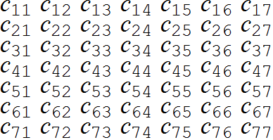
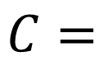
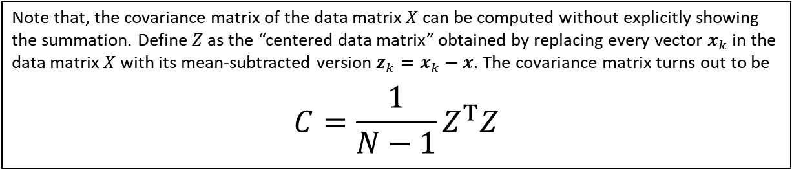
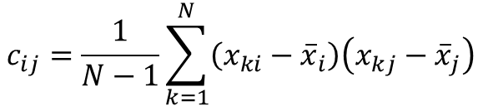
Covariance formula
$$c_{ij}=\frac{1}{N−1}\sum_{k=1}^{N}{\left(x_{ki}−{\overline{x}}_{i}\right)\left(x_{kj}−{\overline{x}}_{j}\right) }$$
$$C=$$
The covariance matrix has a number of special properties. Among them are:
Entries on the principal diagonal, being variances, must always be positive (see thin line)
Symmetrical entries (such as the two entries shown shaded) must be equal to one another
Note that, the covariance matrix of the data matrix $X$ can be computed without explicitly showing the summation. Define $Z$ as the “centered data matrix” obtained by replacing every vector $x_{k}$ in the data matrix $X$ with its mean-subtracted version ${z_{k}=x}_{k}−\overline{x}$. The covariance matrix turns out to be
$$C=\frac{1}{N−1}Z^{T}Z$$

Slide 26



Bayes Classifier (d DIMENSIONS)
np.linalg.inv(....)
np.linalg.dot(....)
In order to classify using d features (height, handspan, voice frequency, … ) we need to use the following formula which contains a generalization of the normal PDFs
$$N_{M}\left(\frac{1}{{\left(2π\right)}^{\frac{d}{2}}{\left|Σ_{M}\right|}^{\frac{1}{2}}}e^{−\frac{1}{2}\left(x−μ_{M}\right) {Σ_{M}}^{−1}{\left(x−μ_{M}\right)}^{T}}\right)$$
M
$$N_{F}\left(\frac{1}{{\left(2π\right)}^{\frac{d}{2}}{\left|Σ_{F}\right|}^{\frac{1}{2}}}e^{−\frac{1}{2}\left(x−μ_{F}\right) {Σ_{F}}^{−1}{\left(x−μ_{F}\right)}^{T}}\right)$$
>
<
F
$$\left\{1×d\right\}$$
$$\left\{d×d\right\}$$
$$\left\{d×1\right\}$$
Turns out to be a scalar, real number
M
$$N_{M} 𝒩\left(x|μ_{M},Σ_{M}\right)$$
>
$$N_{F} 𝒩\left(x|μ_{F},Σ_{F}\right)$$
<
F
np.linalg.det(....)

Slide 27

Step-by-step: PDF of the binormal distribution
It is highly recommended that you define a general function to compute the PDF of a Gaussian distribution in multiple dimensions. At least once, calculate an example by hand (the calculation of the inverse is optional) and track all the intermediate results

Slide 28








Calculation of the PDF of the binormal distribution
The PDF of a Gaussian distribution in $d$ dimensions is given by
$$\frac{1}{{\left(2π\right)}^{\frac{d}{2}}{\left|Σ\right|}^{\frac{1}{2}}}e^{−\frac{1}{2}\left(x−μ\right) Σ^{−1}{\left(x−μ\right)}^{T}}$$
If $x$ and $μ$ are two dimensional vectors and $Σ$ is a $2×2$ matrix, the expression for the PDF can be written in a form more suitable for computation by writing out the variables and parameters explicitly:
$$x=\left\{x_{1},x_{2}\right\} \text{and} μ=\left\{μ_{1},μ_{2}\right\}$$
$Σ=\left(\begin{matrix}c_{11} & c_{12} \\ c_{12} & c_{22}\end{matrix}\right)$ (note that due to the symmetry of the covariance matrix $c_{12}=c_{21}$
Before writing out the final expression for the PDF, a few intermediate quantities are need to be computed:
Define a new vector $z=\left\{z_{1},z_{2}\right\}=$ $\left\{x_{1}−μ_{1},x_{2}−μ_{2}\right\}$
Define $D$ as the determinant $\left|Σ\right|=c_{11}c_{22}−c_{12}^{2}$
Define matrix $A$ as the inverse of the covariance matrix $A=Σ^{−1}=\left(\begin{matrix}a_{11} & a_{12} \\ a_{12} & a_{22}\end{matrix}\right)=\left(\begin{matrix}\frac{c_{22}}{D} & −\frac{c_{12}}{D} \\ −\frac{c_{12}}{D} & \frac{c_{11}}{D}\end{matrix}\right)$
Now the PDF can be written easily computed as
$$\frac{1}{ 2π\sqrt{D}}e^{−\frac{1}{2} \left(a_{11}z_{1}^{2}+2a_{12}z_{1}z_{2}+a_{22}z_{2}^{2}\right)}$$
Click to see worked example.
$$x_{1}=61, { x}_{2}=21,{ μ}_{1}=60,{ μ}_{2}=20$$
$$Σ=\left(\begin{matrix}c_{11} & c_{12} \\ c_{12} & c_{22}\end{matrix}\right)=\left(\begin{matrix}5 & 2 \\ 2 & 1\end{matrix}\right)$$
$z=\left\{z_{1},z_{2}\right\}=$ $\left\{1,1\right\}$
$$\left|Σ\right|=1$$
$$A=\left(\begin{matrix}a_{11} & a_{12} \\ a_{12} & a_{22}\end{matrix}\right)=\left(\begin{matrix}1 & −2 \\ −2 & 5\end{matrix}\right)$$
$$\frac{1}{\text{6.28319}}e^{−\frac{1}{2} \left(2\right)}=\text{0.0585498}$$
Ankit Shah, you have been honored with the Eagle Eye Award for spotting errors on the previous slide.
Congratulations and thank you for your help in improving this presentation.
CLICK TO DISMISS
Next Slide

Slide 29









Calculation of the PDF of the multinormal distribution
The inverse ($d×d$) of the covariance matrix for a given numerical dataset ($N×d$) can be found using callable functions available in most numerical software development platforms.
For the simple case of a $2×2$ covariance matrix $\left[\begin{matrix}c_{11} & c_{12} \\ c_{21} & c_{22}\end{matrix}\right]$, the inverse is readily calculated as $\left[\begin{matrix}c_{22} & −c_{12} \\ {−c}_{21} & c_{11}\end{matrix}\right]/\left(c_{11}c_{22}−c_{12}c_{21}\right)$.
Click on any box inside this formula to get a description. Click on the same box again to dismiss.
The covariance matrix ($d×d$) for a given numerical dataset ($N×d$) can be found using callable functions available in most numerical software development platforms.
$$\frac{1}{{\left(2π\right)}^{\frac{d}{2}}\sqrt{\left|Σ\right|}}e^{−\frac{1}{2} \left(x−μ\right) Σ^{−1}{\left(x−μ\right)}^{T}}$$
For a given feature vector $x$the scalar quantity $\left(x−μ\right) Σ^{−1}{\left(x−μ\right)}^{T}$ can be found using matrix multiplication functions available in most numerical software development platforms.
Alternatively, by defining the $d$- dimensional vector $z=x−μ$ and the matrix ${A=Σ}^{−1}$, the equivalent scalar quantity $z A z^{T}$ is easily calculated as $\sum_{j=1}^{d}{\sum_{k=1}^{d}{z_{j}z_{k}a_{jk}}}$
The determinant of the covariance matrix can be found using callable functions available in most numerical software development platforms.
For the simple case of a $2×2$ covariance matrix $\left[\begin{matrix}c_{11} & c_{12} \\ c_{21} & c_{22}\end{matrix}\right]$, the determinant is readily calculated as $c_{11}c_{22}−c_{12}c_{21}$.
Next Slide

Slide 30

Step-by-step: How can I build a 2D Bayesian Classifier?
Separate the data into male and female subsets
Find the mean vector and the covariance matrix separately for males and females. You may use a built-in function to compute these parameters.
For each requested query (height-handspan vector $x=\left\{h,s\right\}$) compute the posterior probabilities
$$P\left(F|x\right)=\frac{N_{F}\left(\frac{1}{2π{ \left|Σ_{F}\right|}^{\frac{1}{2}}}e^{−\frac{1}{2}\left(x−μ_{F}\right) {Σ_{F}}^{−1}{\left(x−μ_{F}\right)}^{T}}\right)}{\left(N_{M}\left(\frac{1}{2π{ \left|Σ_{M}\right|}^{\frac{1}{2}}}e^{−\frac{1}{2}\left(x−μ_{M}\right) {Σ_{M}}^{−1}{\left(x−μ_{M}\right)}^{T}}\right)\right)+\left(N_{F}\left(\frac{1}{2π{ \left|Σ_{F}\right|}^{\frac{1}{2}}}e^{−\frac{1}{2}\left(x−μ_{F}\right) {Σ_{F}}^{−1}{\left(x−μ_{F}\right)}^{T}}\right)\right)}$$
$$P\left(M|x\right)=\frac{N_{M}\left(\frac{1}{2π{ \left|Σ_{M}\right|}^{\frac{1}{2}}}e^{−\frac{1}{2}\left(x−μ_{M}\right) {Σ_{M}}^{−1}{\left(x−μ_{M}\right)}^{T}}\right)}{\left(N_{M}\left(\frac{1}{2π{ \left|Σ_{M}\right|}^{\frac{1}{2}}}e^{−\frac{1}{2}\left(x−μ_{M}\right) {Σ_{M}}^{−1}{\left(x−μ_{M}\right)}^{T}}\right)\right)+\left(N_{F}\left(\frac{1}{2π{ \left|Σ_{F}\right|}^{\frac{1}{2}}}e^{−\frac{1}{2}\left(x−μ_{F}\right) {Σ_{F}}^{−1}{\left(x−μ_{F}\right)}^{T}}\right)\right)}$$
See “Calculation of the PDF of the binormal distribution” for hints on computing the shaded quantities.
Perform classification by comparing $P\left(F|x\right)$ and $P\left(M|x\right)$.

Slide 31
Topic 2 Summary
Here is what you learned in Topic 2
Histograms, normally used to graphically represent univariate data (i.e. 1D data like height) can also be constructed to represent multivariate data (e.g. 2D data like height & handspan)
Just as the mean and the standard deviation characterize univariate Gaussian data, the mean vector and the covariance matrix characterize multivariate Gaussian data
The PDF of the multivariate Gaussian distribution is more complex than the univariate version, but can still be understood and computed using matrix/vector operations
The formula for the PDF of the multivariate Gaussian distribution is often used in machine learning

